Slide 1

TL Presentation
Group:6

Slide 2
1
PART 1
TDR overview
Modules
2
PART 2
TDR experiment
3
PART 3
Homework

Slide 3
01
TDR Overview

Slide 4
TDR Overview
TDR is the acronym for Time Domain Reflectometry – it can visually display and measure the electrical energy reflected by the circuit (PCB, cable, IC package, ...).
The signal is transmitted on a certain transmission path. When an impedance change occurs in the transmission path, part of the signal will be reflected, and another part of the signal will continue to be transmitted along the transmission path.
TDR calculates the impedance change by measuring the voltage amplitude of the reflected wave; as long as the time value from the reflection point to the emission point is measured, the position of the impedance change point in the transmission path can be calculated.

Slide 5
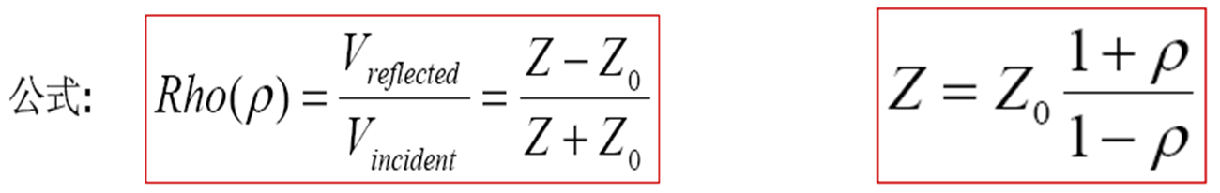
TDR Overview
The basic formula of TDR is as follows.
It can be seen from the above formula that since the incident voltage is known, the reflection coefficient ρ value can be calculated as long as the voltage value of the reflection point is measured;
The output impedance Z0 of the instrument can be set by the user, so that the impedance Z value of the reflection point can be calculated.

Slide 6
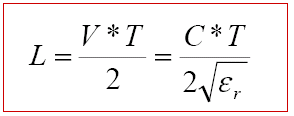
TDR Overview
The TDR can measure the transmission delay of the reflection point, and the position of the reflection point can be calculated from the transmission delay value.
In the formula, V is signal transmission speed in the medium. T is the delay value read on the TDR instrument. C means the speed of light. And ε is dielectric constant.

Slide 7
TDR Overview
Multiple extensions to basic TDR:
Differential TDR
Time Domain Transmission
Crosstalk

Slide 8
02
TDR TEST1

Slide 9
Model and Problem
When the terminal impedance changes, what do you observe?
Z_{L}= ∞ , Z_{L}= Z_{C}, Z_{L}= 0

Slide 10
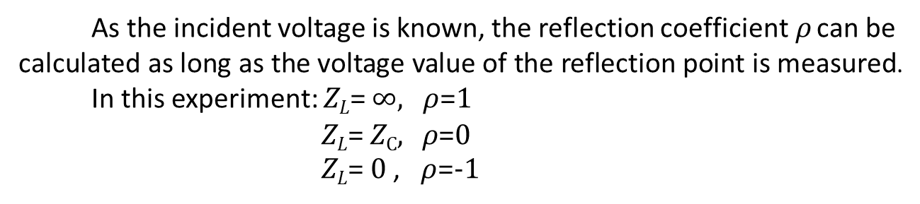
Analysis of Test 2
As the incident voltage is known, the reflection coefficient$ρ$ can be calculated as long as the voltage value of the reflection point is measured.
In this experiment: Z_{L}= ∞, $ρ$=1
Z_{L}= Z_{C}, $ρ$=0
Z_{L}= 0 , $ρ$=-1

Slide 11
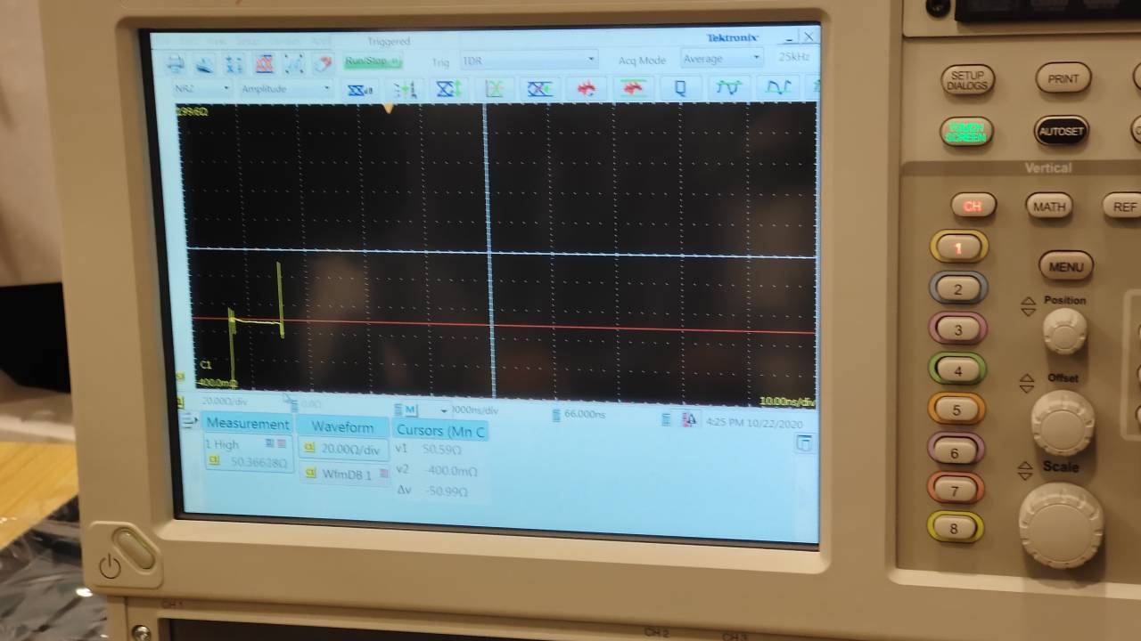
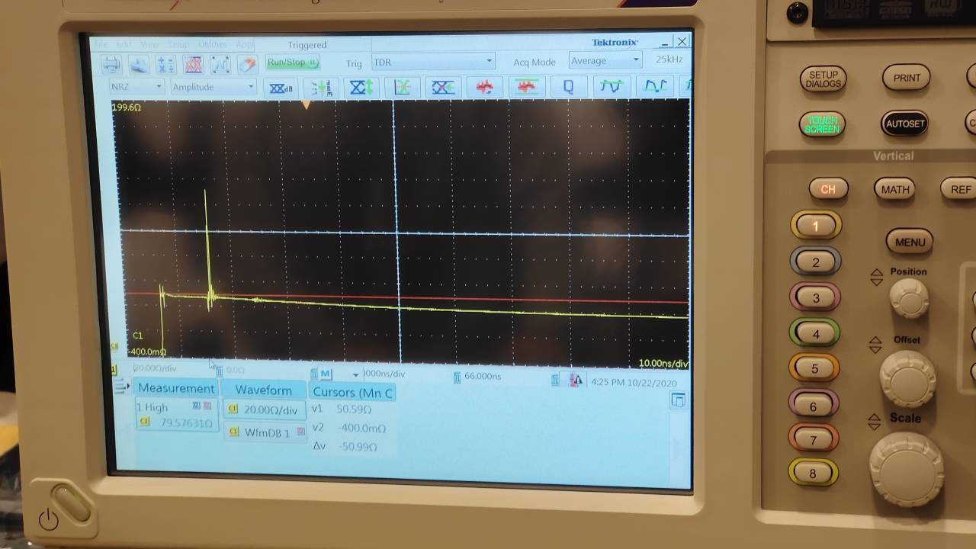
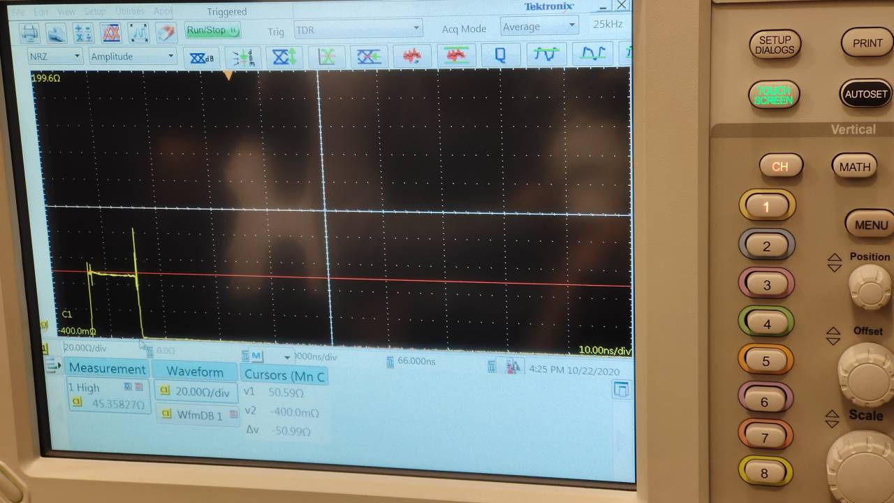
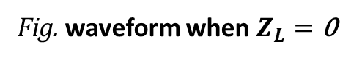
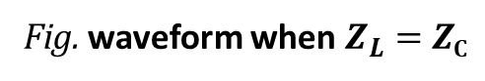
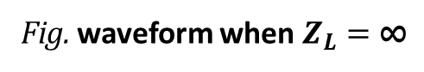
Experimental Result
Fig. waveform when $Z_{L}=\text{∞}$
Fig. waveform when $Z_{L}=\text{Z}\text{C}$
Fig. waveform when $Z_{L}=\text{0}$

Slide 12
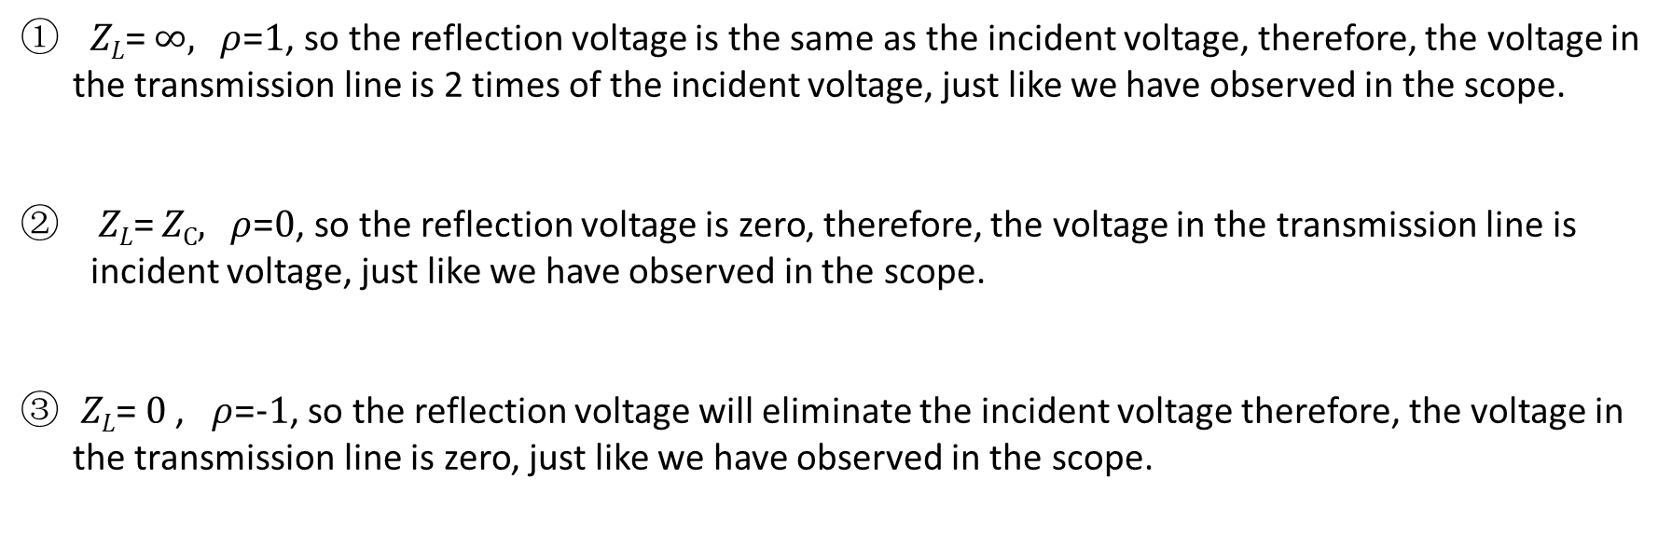
Experimental conclusion
Z_{L}= ∞, $ρ$=1, so the reflection voltage is the same as the incident voltage, therefore, the voltage in the transmission line is 2 times of the incident voltage, just like we have observed in the scope.
Z_{L}= Z_{C}, $ρ$=0, so the reflection voltage is zero, therefore, the voltage in the transmission line is incident voltage, just like we have observed in the scope.
Z_{L}= 0 , $ρ$=-1, so the reflection voltage will eliminate the incident voltage therefore, the voltage in the transmission line is zero, just like we have observed in the scope.

Slide 13
Model and Problem
The dielectric constant of the coaxial cable ε_{r} is 1.6.
What’s the wave velocity along TL1?
What’s the length of TL1?

Slide 14
Experimental conclusion
In this task we are assigned to derive the velocity along the TLI1, and get the length of TL1.
Since the dielectric constant of the coaxial cable, so use the formulation we can get the velocity is:
To get the length of the TL1, we can use the following formulation:
In the scope we can read the is 8.59ns, so the length of the TL1 is 1.015m

Slide 15
03
TEST 2

Slide 16
Model and Problem
At the fault point, the impedance is incontinuous or distorted.
Where is the fault point? (length of TL2)

Slide 17
Analysis of Test 2
At the fault point on the transmission line, the impedance of the transmission line is discontinuous or distorted, causing a portion of the incident voltage of the transmission line to be abnormally reflected back. Therefore, the TDR measurement technique can be used to measure the impedance of the transmission line and observe the abnormal change point of the transmission line to determine the position of the fault point on the transmission line.
In this experiment, the distance from the fault point to the input port of the transmission line is the length of the transmission line TL2.

Slide 18
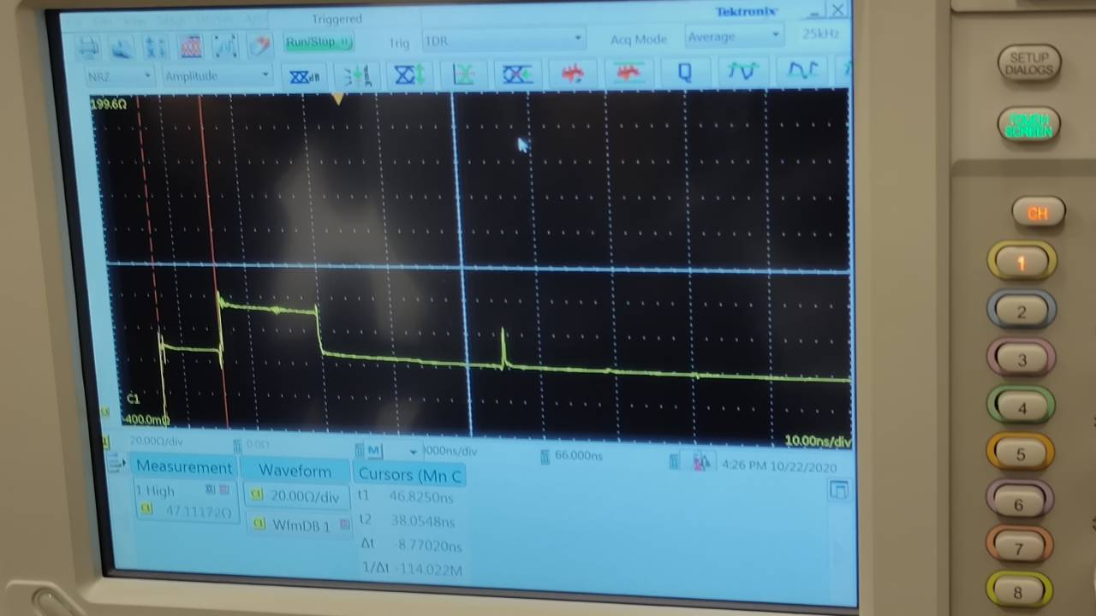
Experimental Result
Waveform Showing the Fault Point

Slide 19
Experimental conclusion
In this experiment, the fault point of the transmission line is located at 1.04m from the input port of the transmission line, that is, the length of the transmission line TL2 is 1.04m.

Slide 20
04
TEST 3

Slide 21
Model and problem
varied
distance
Problem: The distance between conductors varies, what do you observe?

Slide 22
Analysis of Test 3
The coupling between the two wires includes both electric field coupling and magnetic field coupling.
Electric field coupling：It refers to two conductors in a circuit. When they are close together and there is a potential difference, the electric field of the conductor in one circuit generates an electric field induction phenomenon on the conductor in the other circuit.
Magnetic field coupling :It is based on the principle of electromagnetic induction. The alternating current flowing in one conductor loop generates an induced voltage in the other loop through the alternating magnetic field to realize energy transfer.

Slide 23
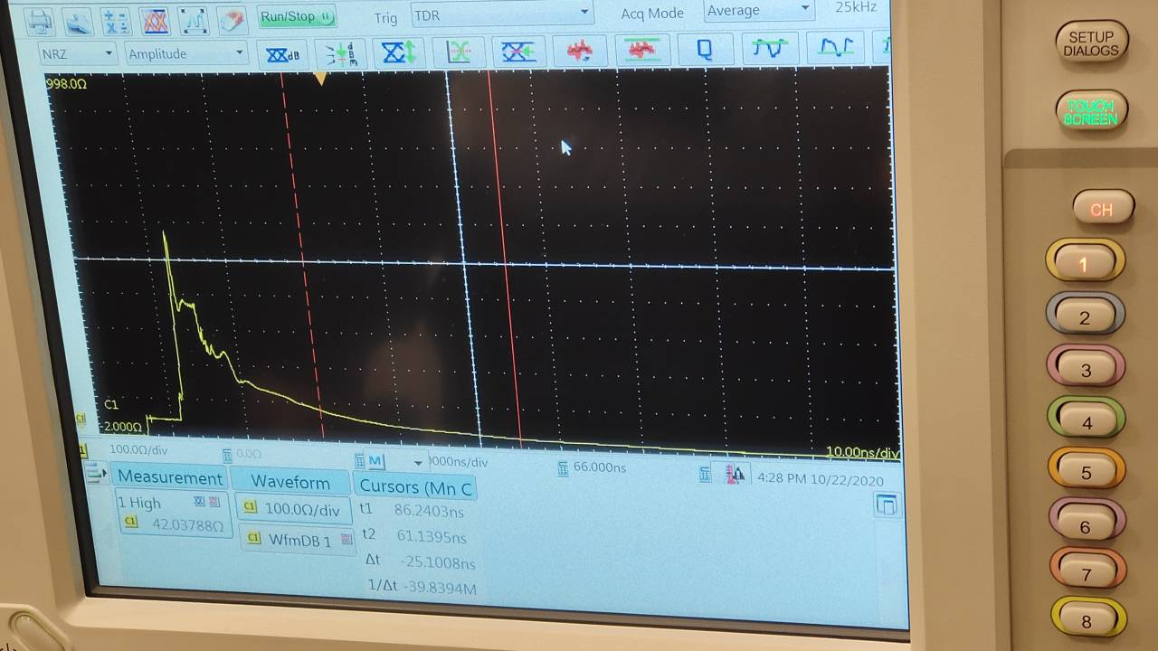
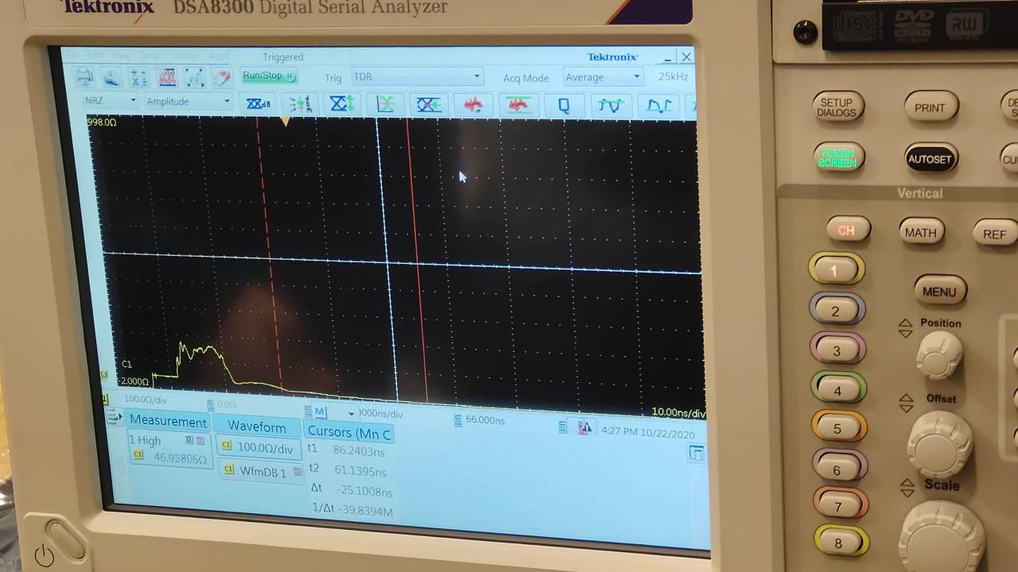
Experimental result
The phenomenon is shown in the Fig.1 and 2.
Figure 1:waveform when tow conductors are near
Figure 2:waveform when tow conductors are a little far away then Fig.1

Slide 24
Experimental Conclusion
The closer the distance between the conductors, the higher the amplitude of the fluctuation
The coupling between the two wires includes both electric field coupling and magnetic field coupling.
Magnetic field coupling can be analyzed by mutual coupling inductance between two conductors, generally denoted by M.

Slide 25
05
Homework

Slide 26
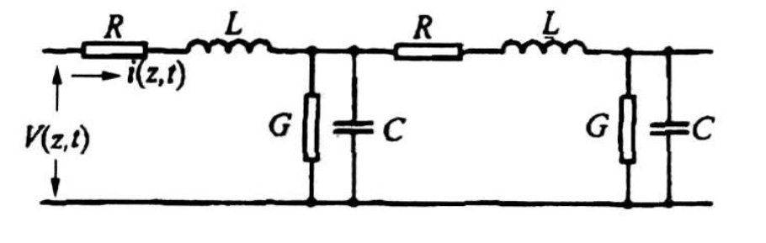
Homework 1
The Derivation of Telegraph Equation - Circuit Theory
The voltage across and the current carried by the transmission line is a function of time t and spatial position z.
Consider that the parameters of the transmission line are uniformly distributed, we can get the equivalent circuit as shown in the figure below
where R=R'dz, L=L'dz, G=G'dz, C=C'dz.
R',L',G',C' are the per-unit length parameters

Slide 27
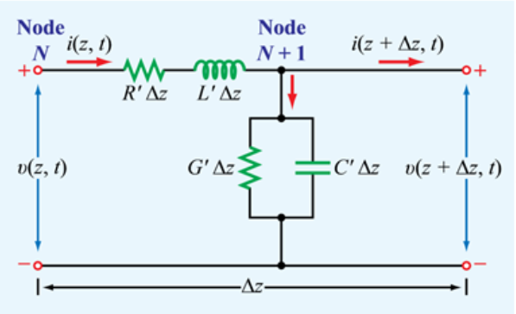
Homework 1
When there is a spatial difference , the voltage and current at the N node are and . The voltage and current at the N+1 node are and
Through the KVL, we can obtain:
(1)
dividing , and taking the limit
(2)

Slide 28
Homework 1
Through the KCL, we can obtain:
(3)
dividing , and taking the limit
(4)

Slide 29
Homework 1
We can get the Telegraph Equation in time domain as follows:
in frequency domain:

Slide 30
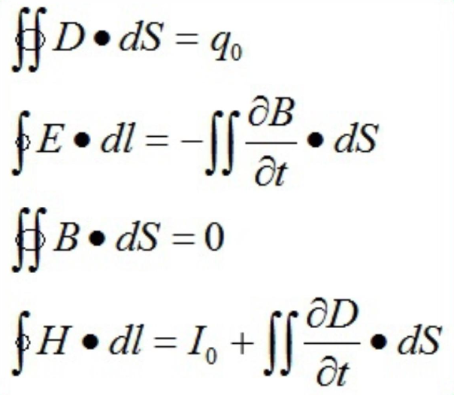
Homework 1
The Derivation of Telegraph Equation - Maxwell Equations
Maxwell Equations in Integral Form:

Slide 31
Homework 1
Use Faraday's law
① ② ③ ④ ⑤
We can see term ① and ③ is the voltage across the trasmission line
Term ② and ④ can be defined as the voltage drop causing by the resistance:

Slide 32
Homework 1
① ② ③ ④ ⑤
Term ⑤ is the change rate of flux penetating, which equals to
Substitute those into the equation and divided by , we can get

Slide 33
Homework 1
Taking the limit , we can get:
(1)

Slide 34
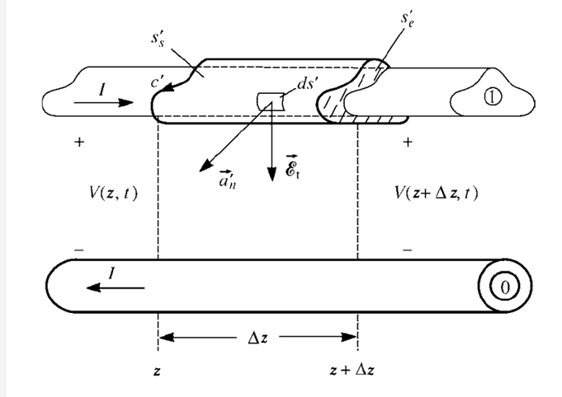
Homework 1
Use the equation of conservation of charge:
over the caps:
over the sides of the surface:
(transverse conduction current)
(displacement current)

Slide 35
Homework 1
The right side of the charge conservation equation can be expressed as:
Substitute those into the equation and divided by , we can get
Taking the limit , we can get:
(2)

Slide 36
Homework 1
So we get the telegraph equation in time domain:
(1)
(2)

Slide 37
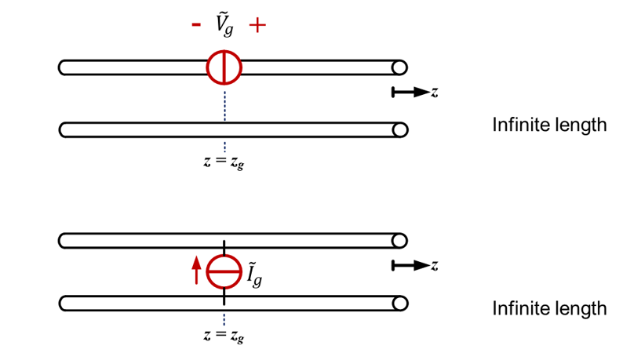
Homework 2
Homework2:
Solutions for telegraph equations excited by lumped source---Green Function

Slide 38
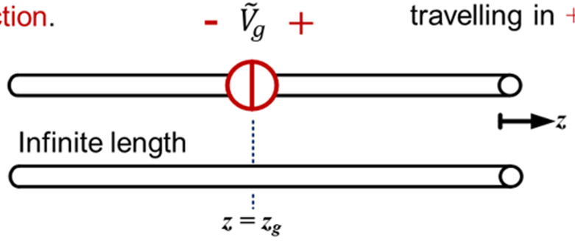
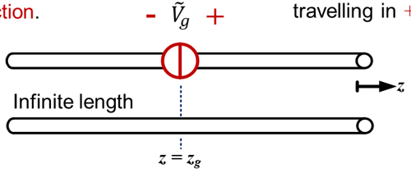
Homework 2
TL excited by a lumped voltage source
For , there is only ,
travelling in direction.
For , there is only ,
travelling in direction.
At , current is continuous while there is a voltage difference .
For ,
For ,

Slide 39
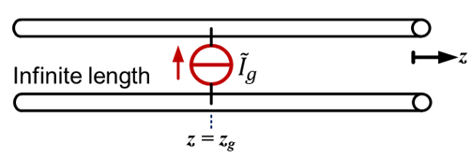
Homework 2
TL excited by a lumped current source
At , voltage is continuous while there is a current difference .
Siminarly, one can obtain:
For ,
For ,

Slide 40
Thank you for watching!

